Slide 1
Introduction
This document showcases my solutions to the SQL Advent Calendar Challenge, curated by Dawn Choo. The challenge consists of 24 SQL problems, intended to be solved daily from December 1st through Christmas Eve, 2024.
https://www.sqlcalendar.com/app/advent-calendar

Slide 2
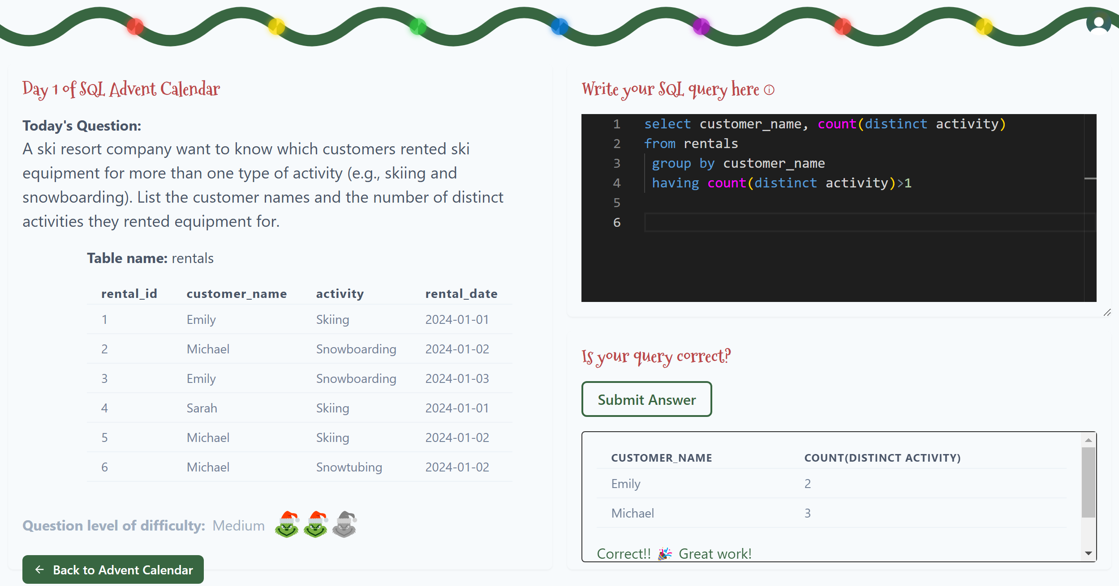
Day 1

Slide 3
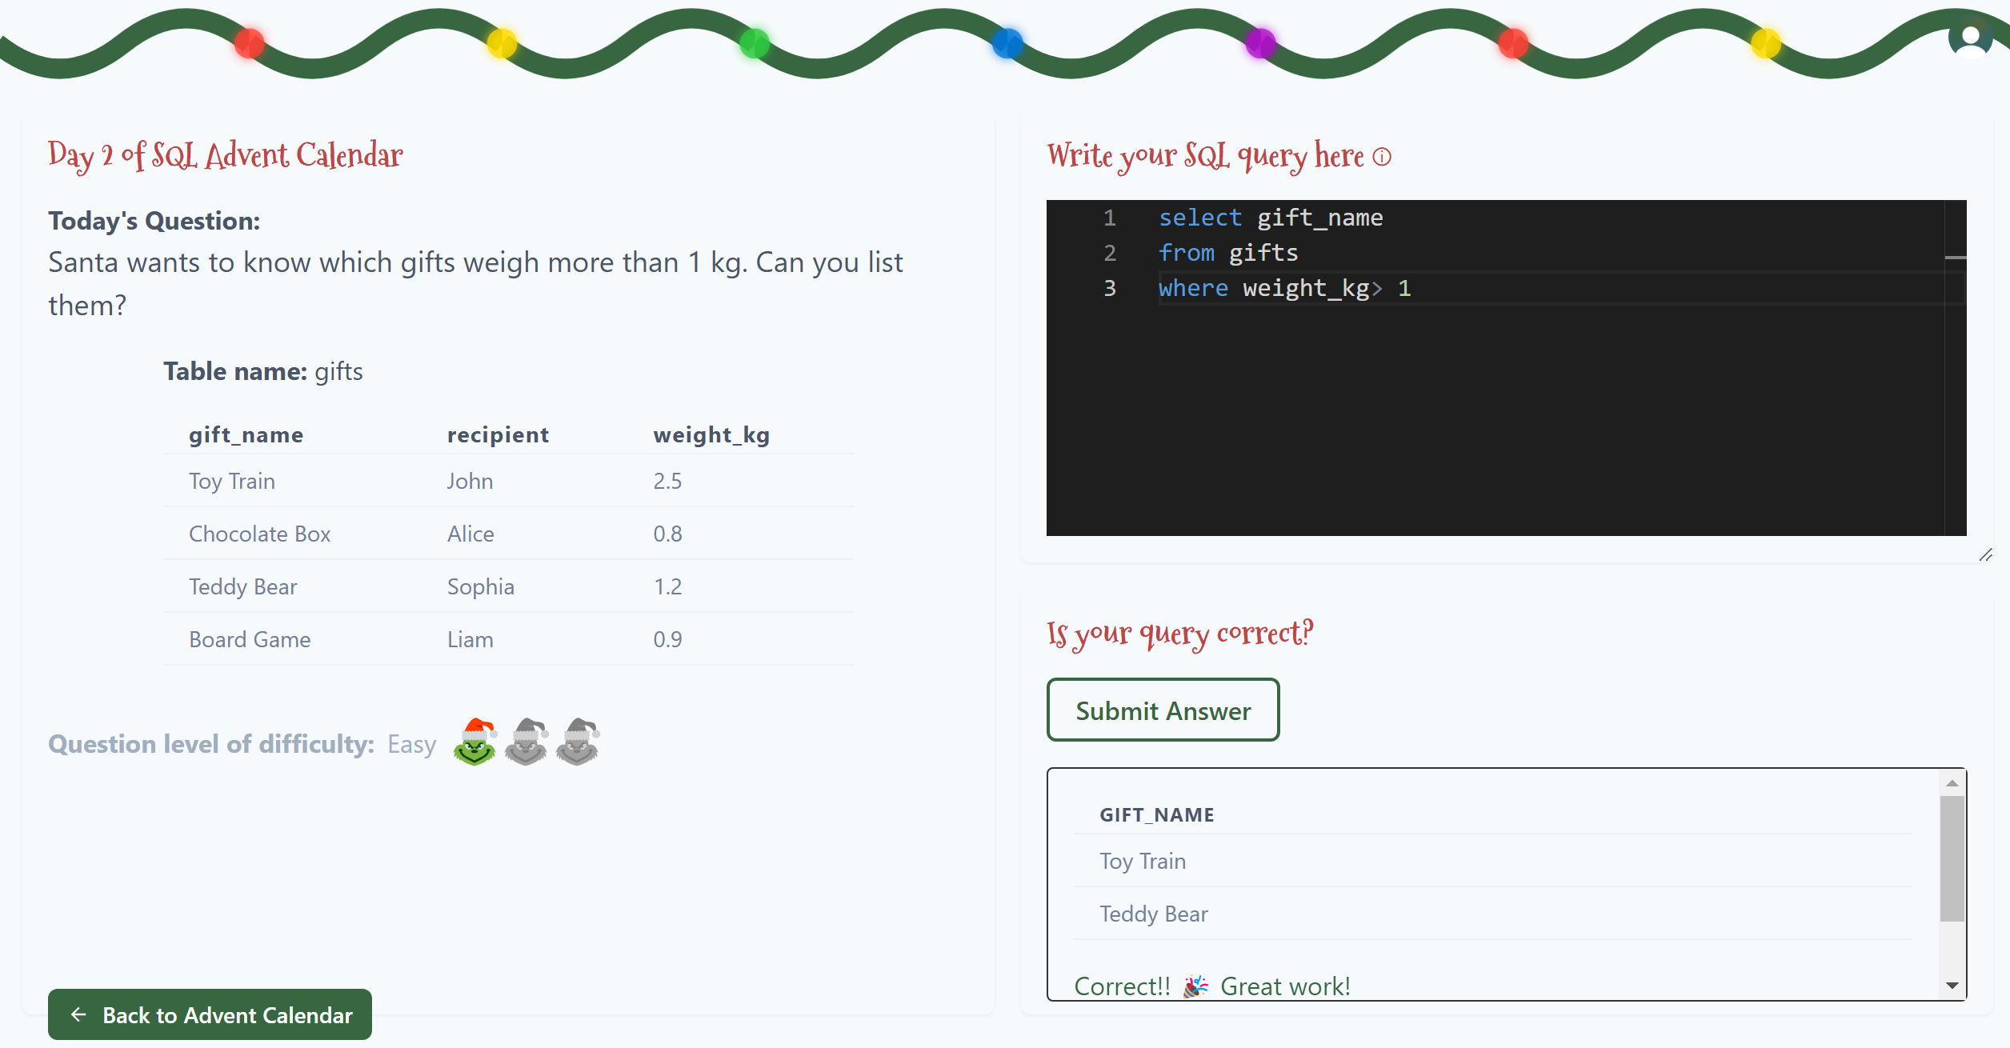
Day 2

Slide 4
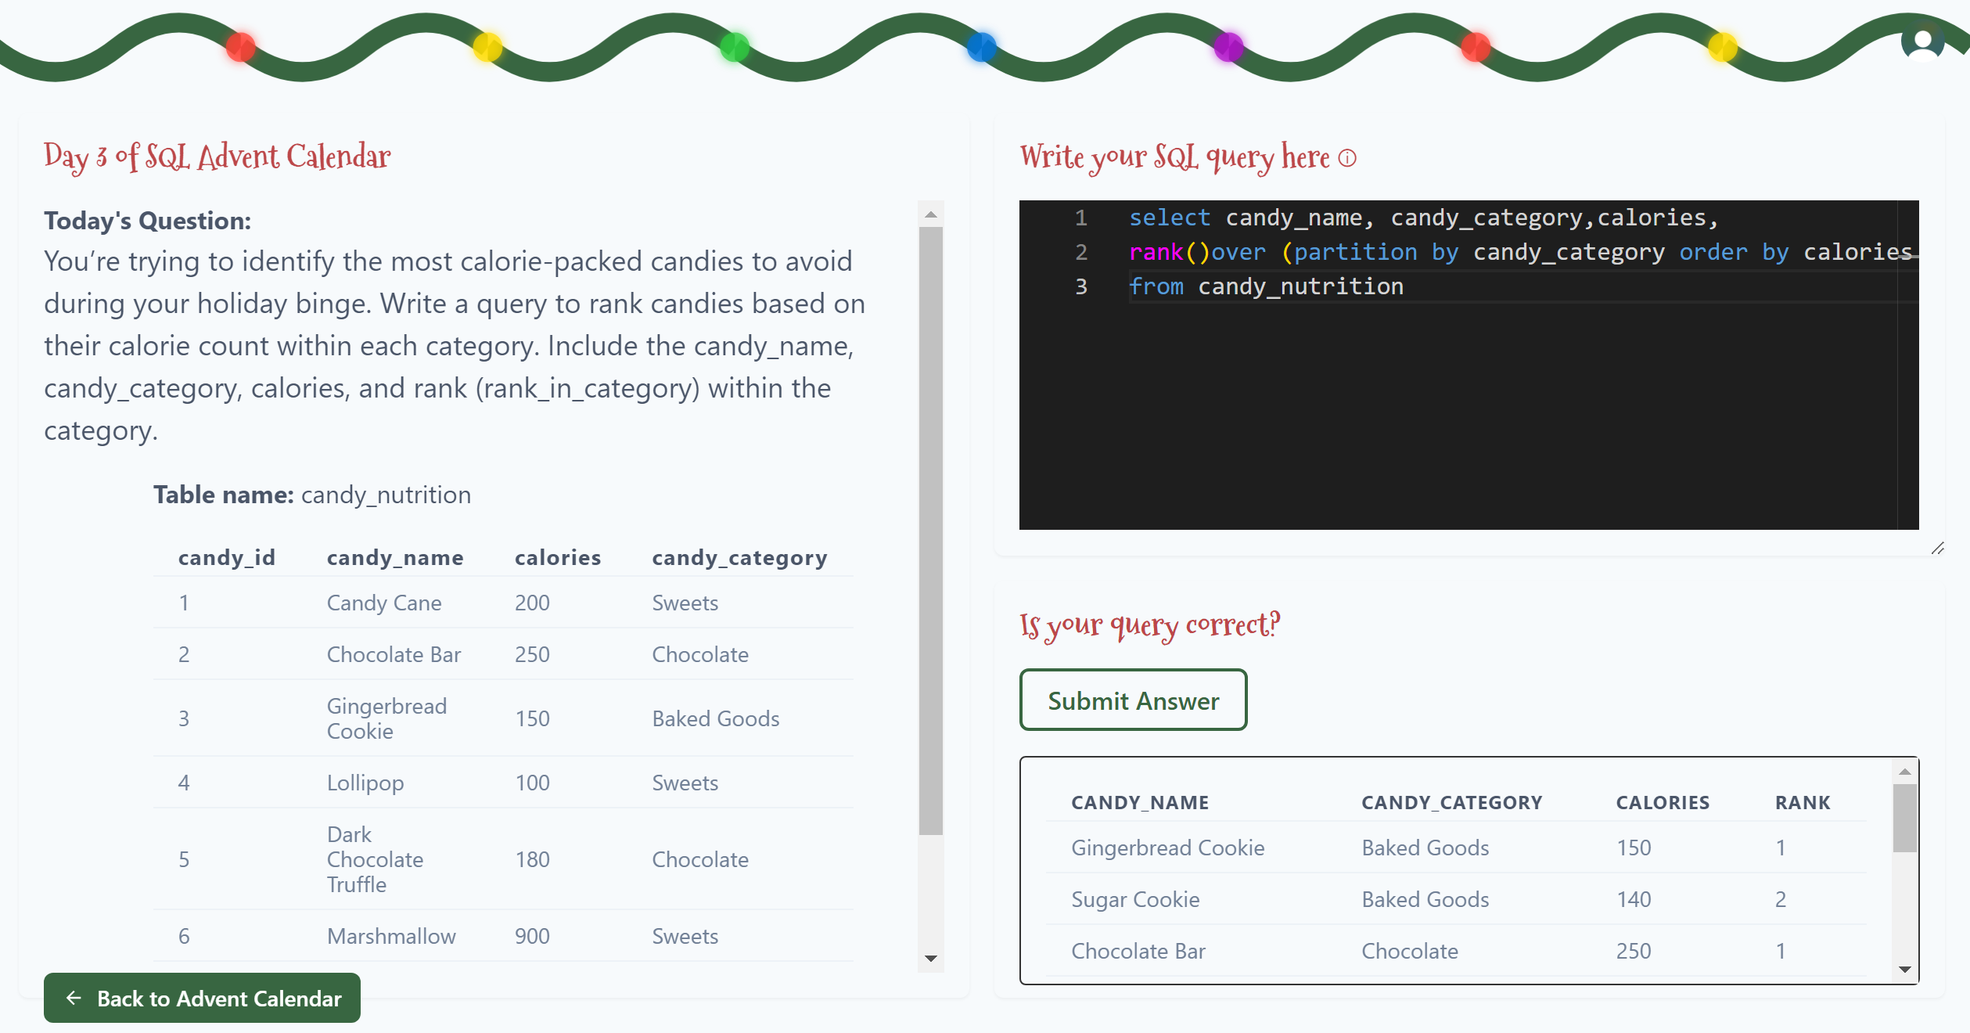
Day 3

Slide 5
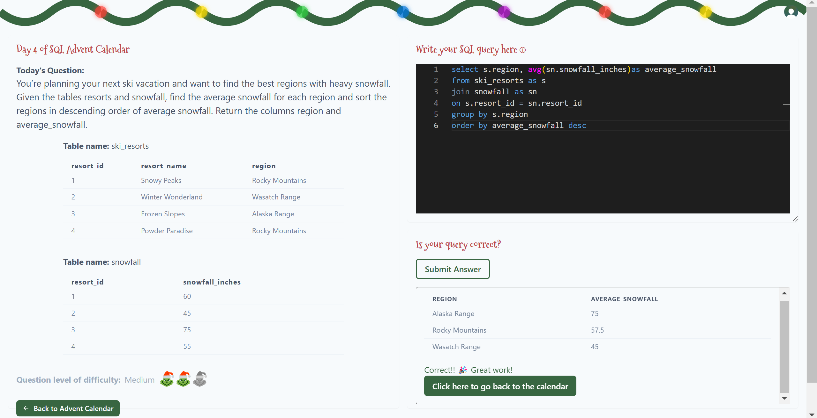
Day 4

Slide 6
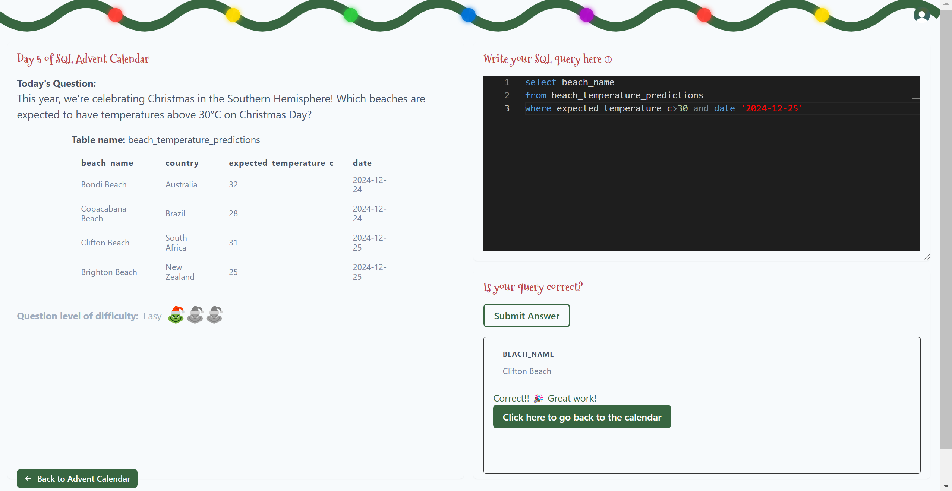
Day 5

Slide 7
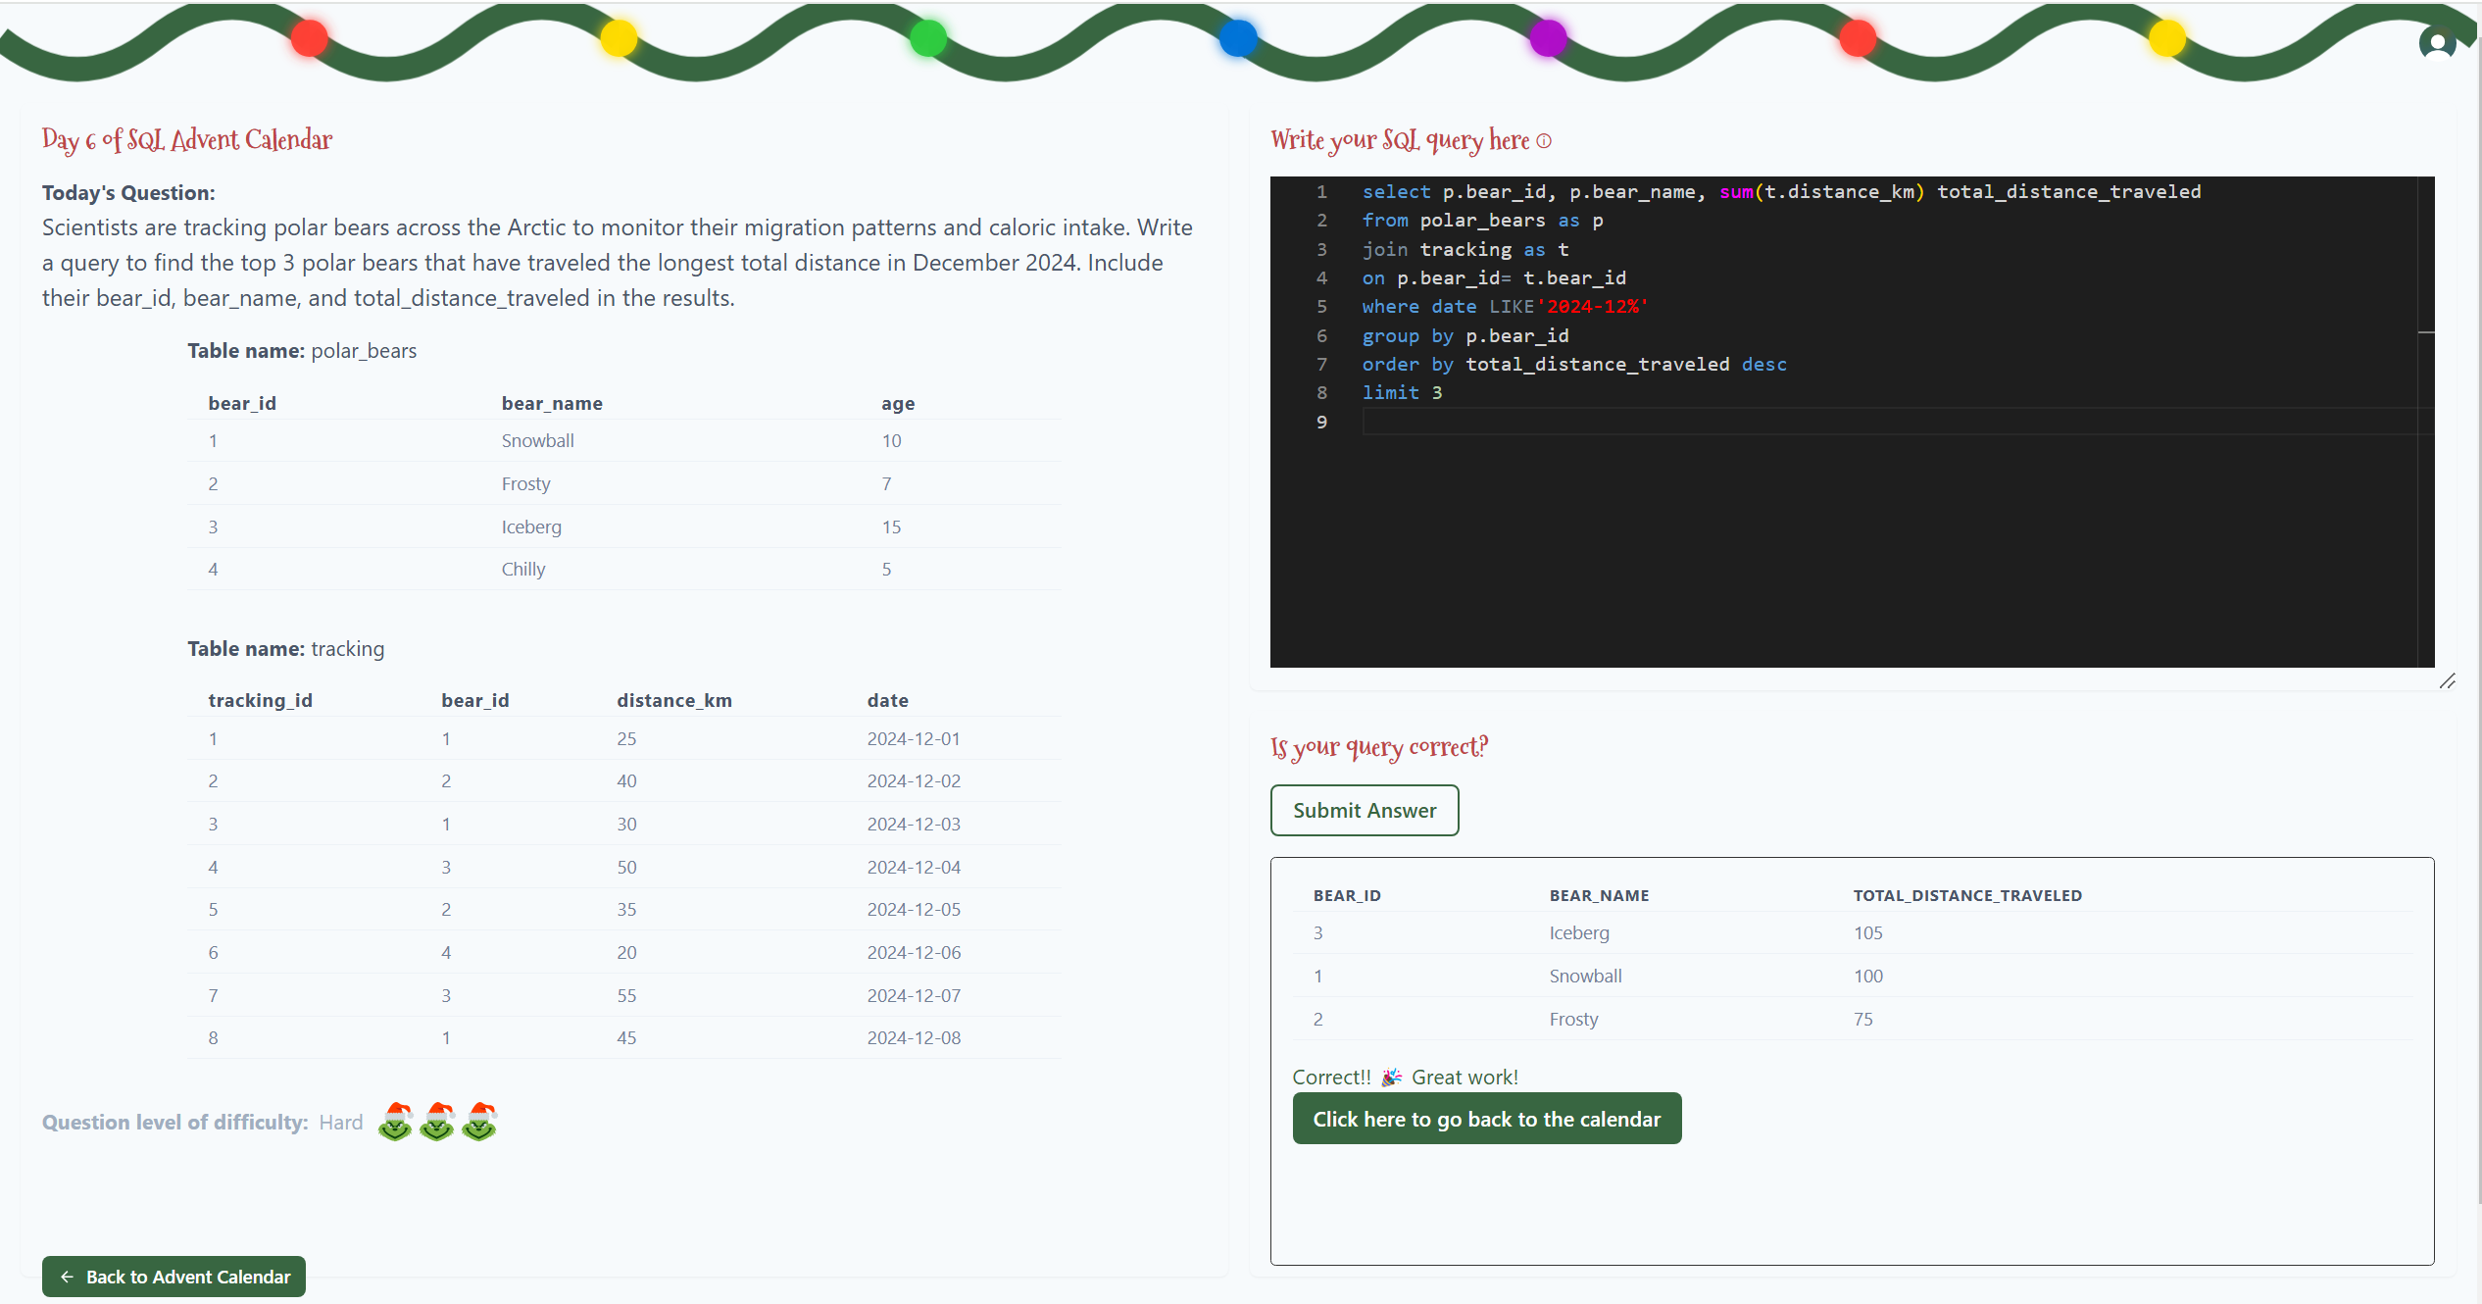
Day 6

Slide 8
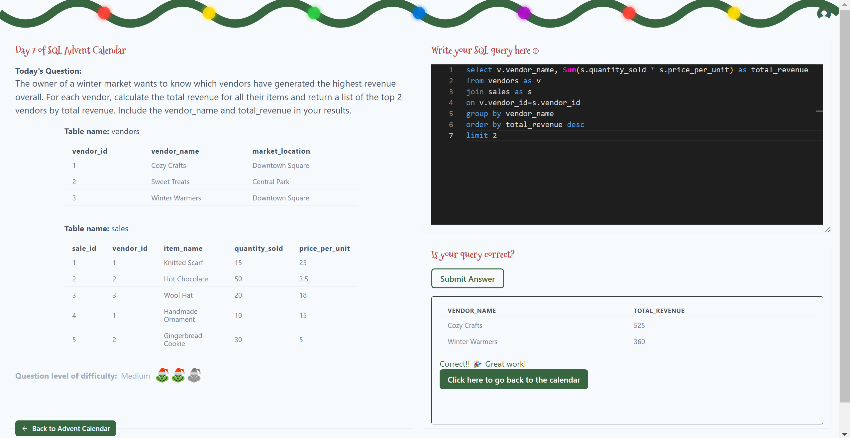
Day 7

Slide 9
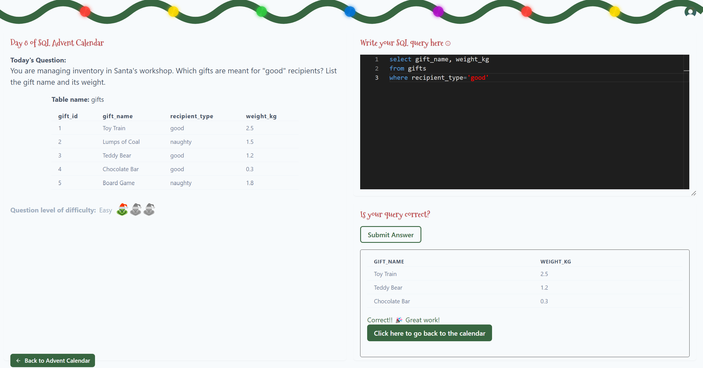
Day 8

Slide 10
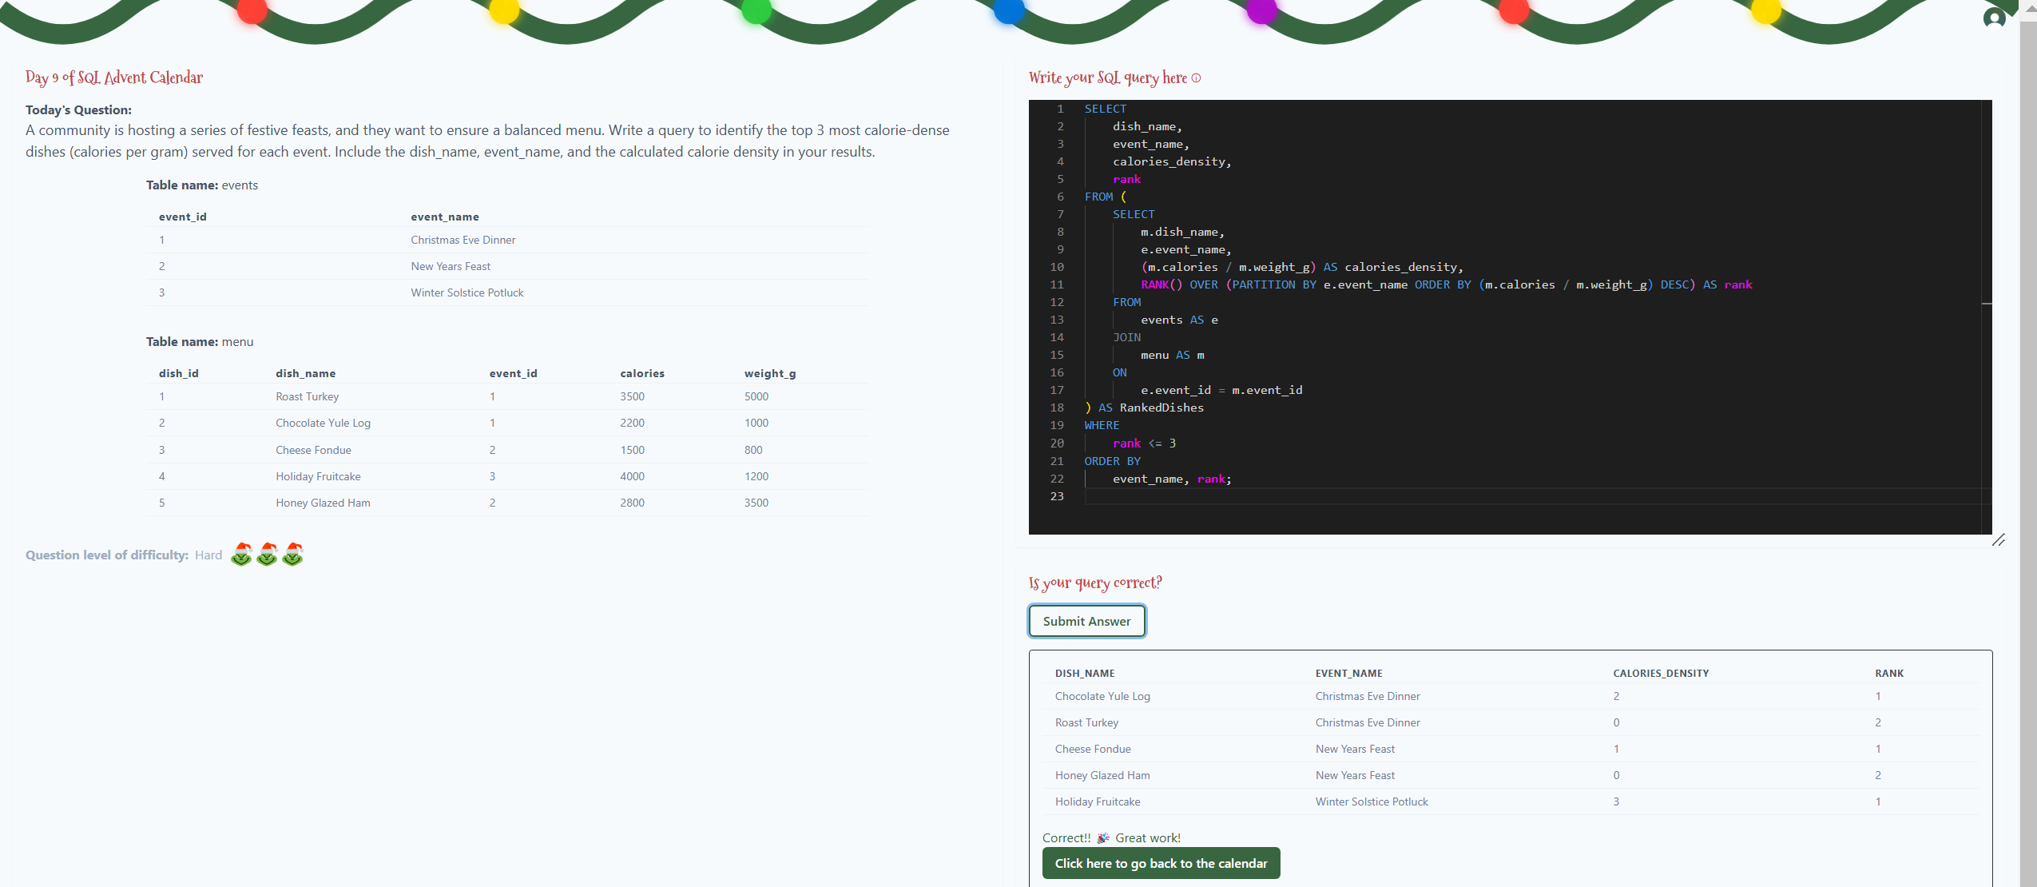
Day 9

Slide 11
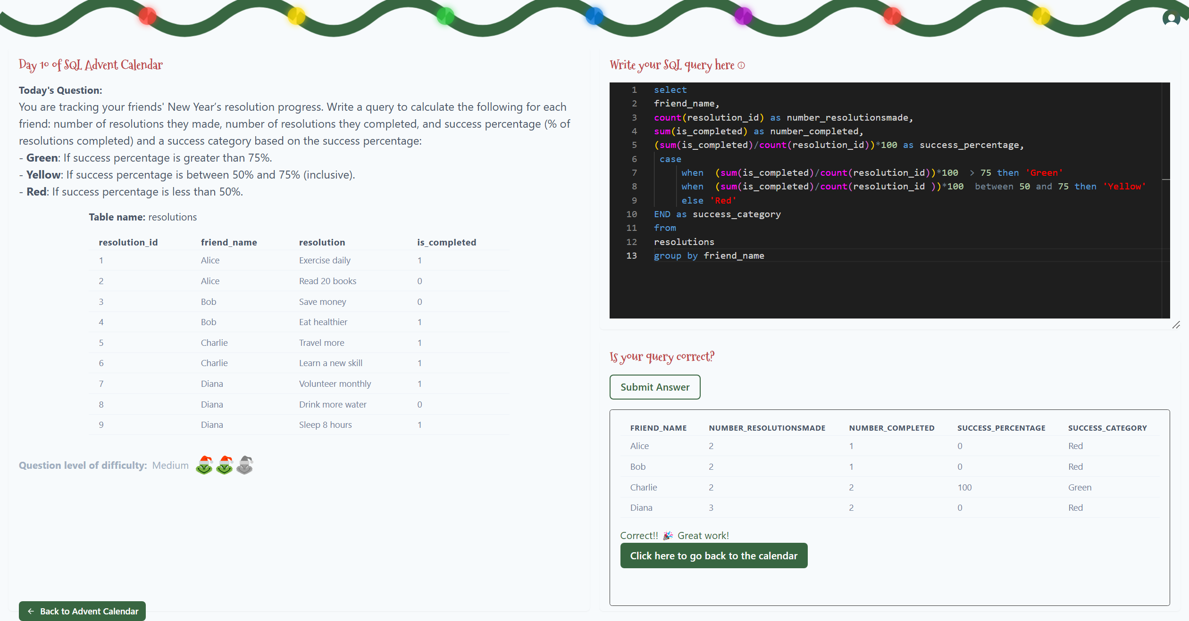
Day 10

Slide 12
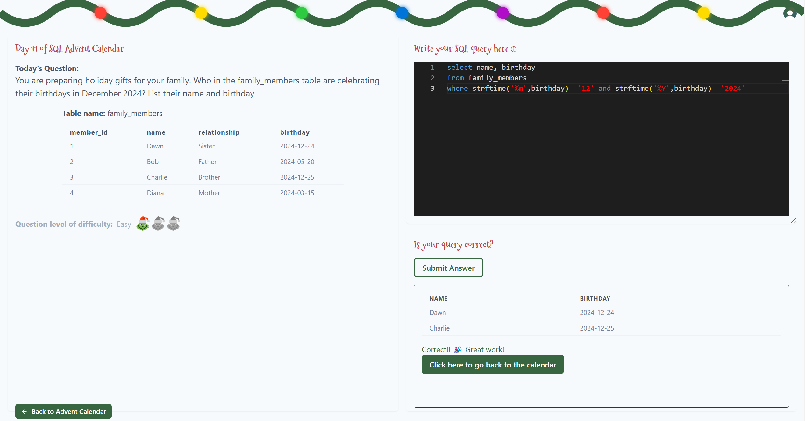
Day 11

Slide 13
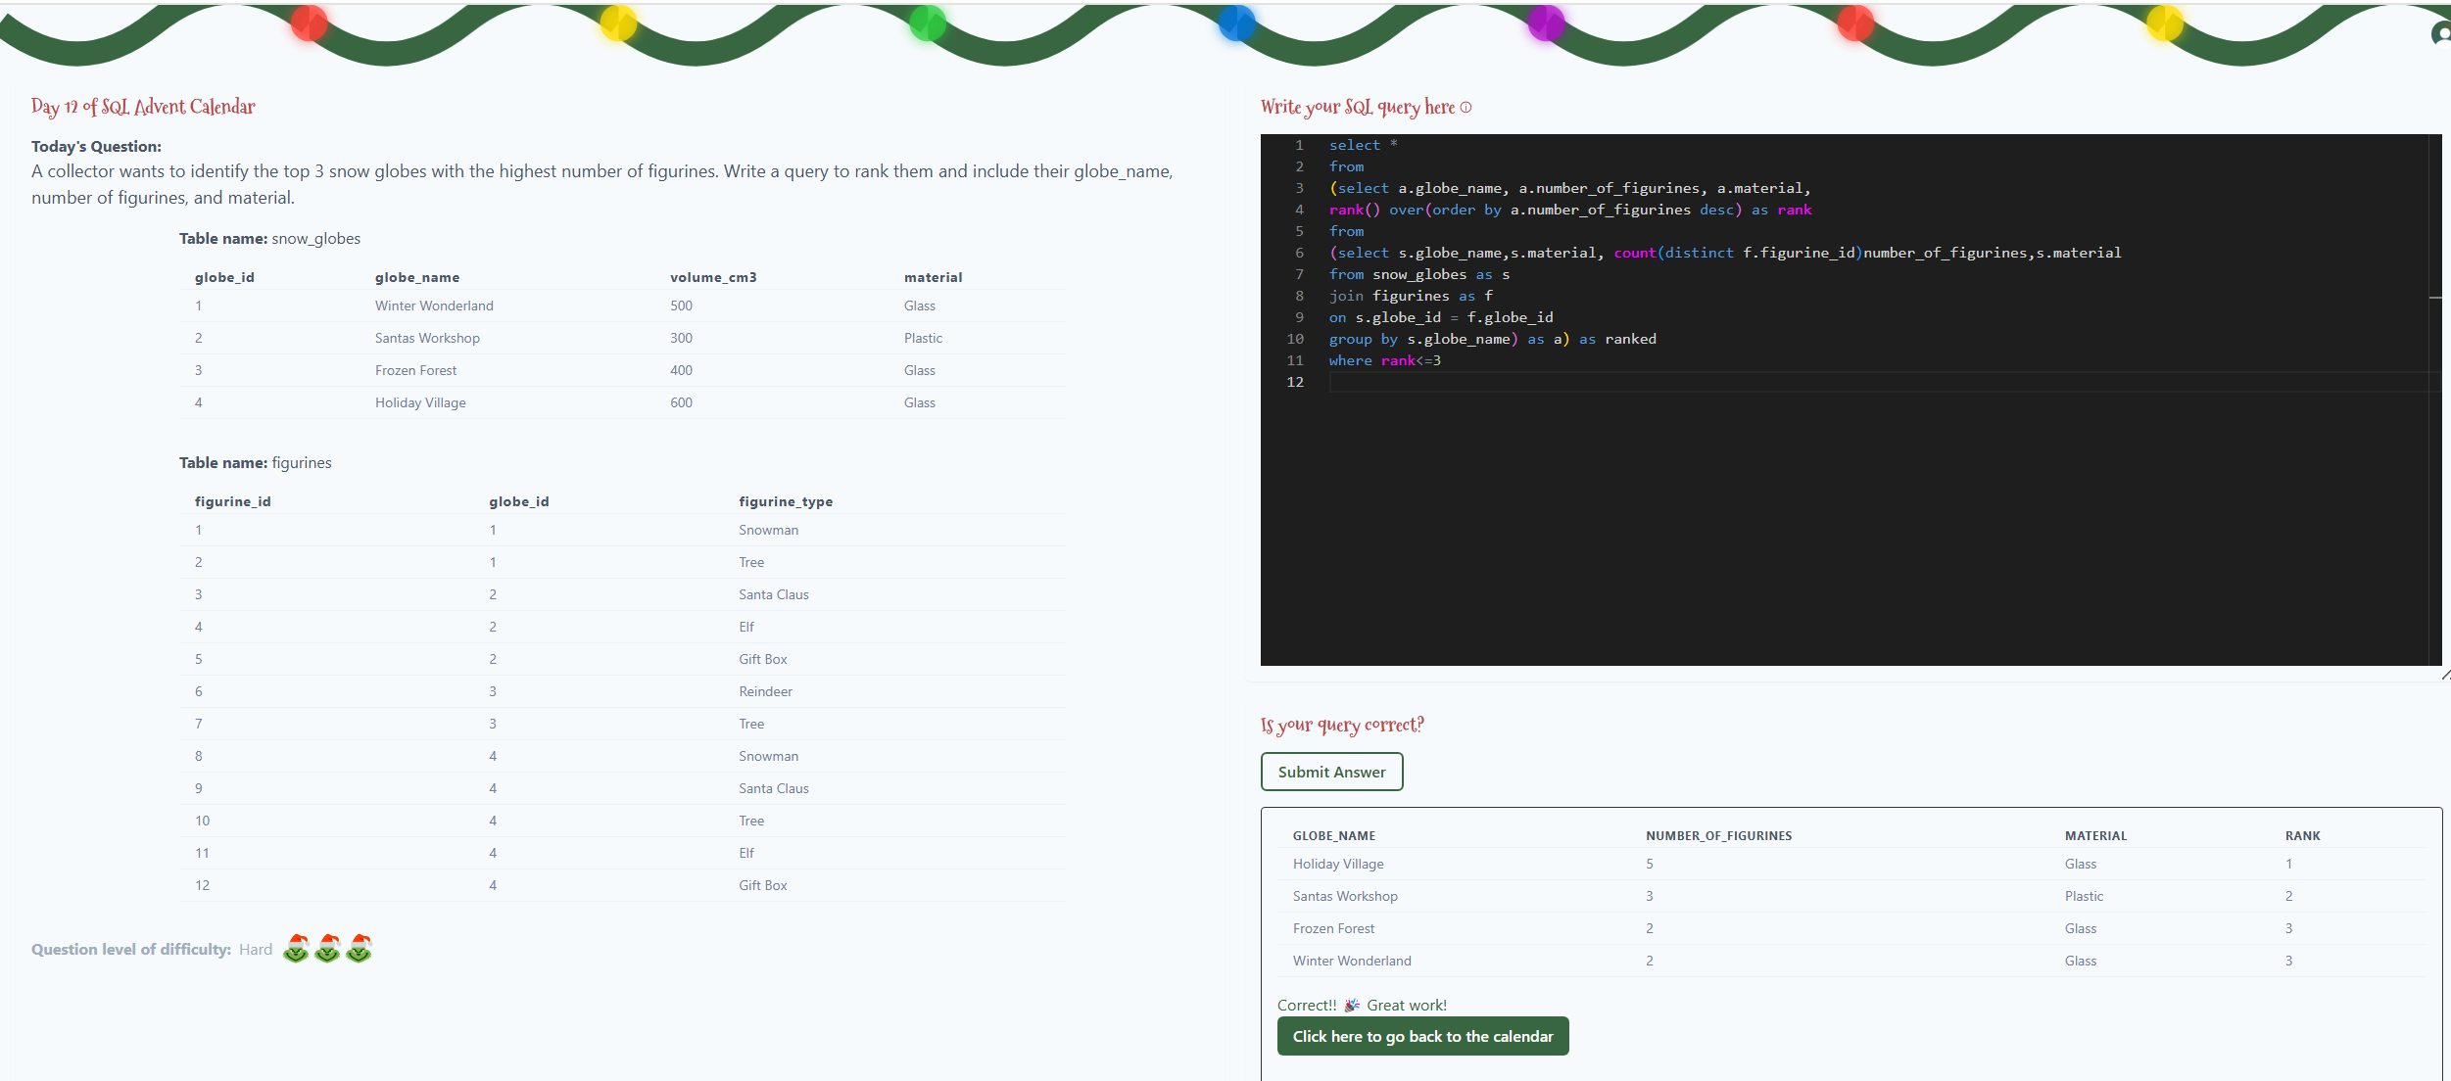
Day 12

Slide 14
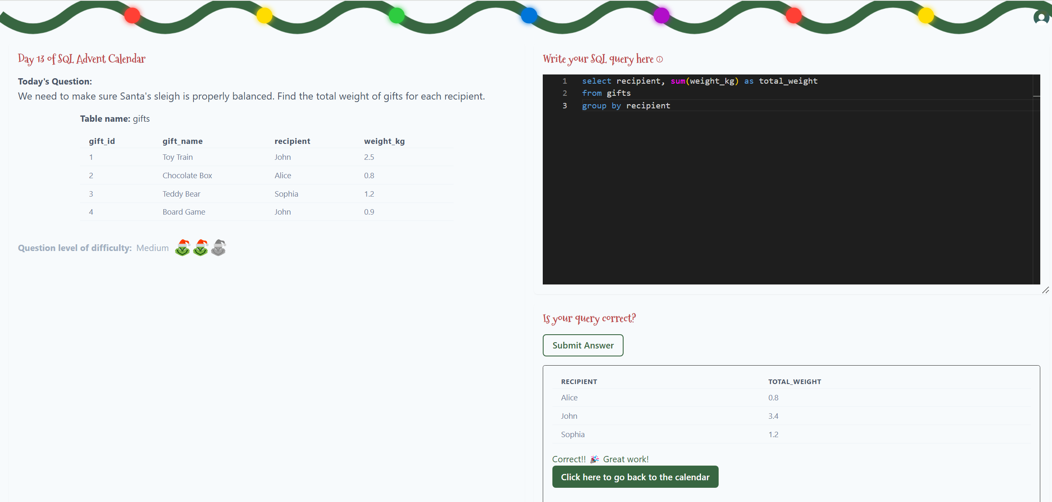
Day 13

Slide 15
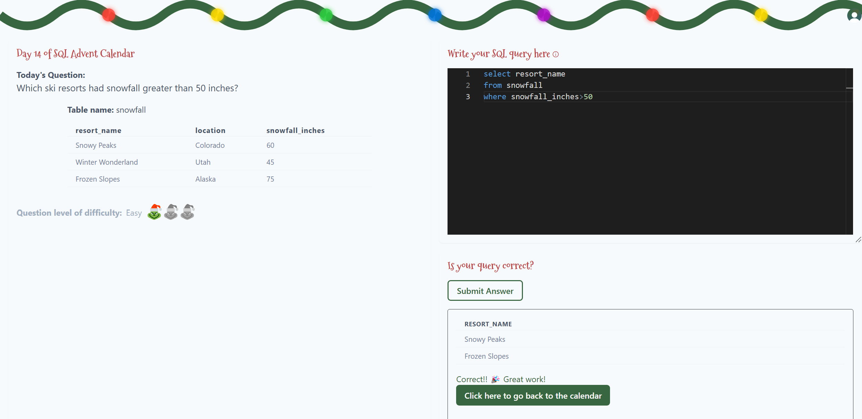
Day 14

Slide 16
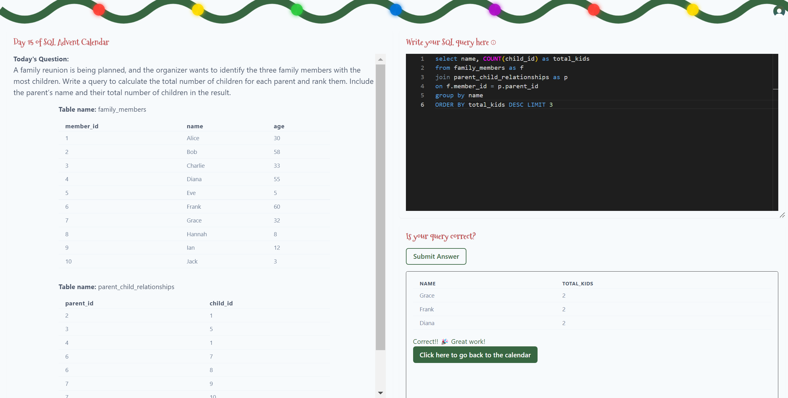
Day 15

Slide 17
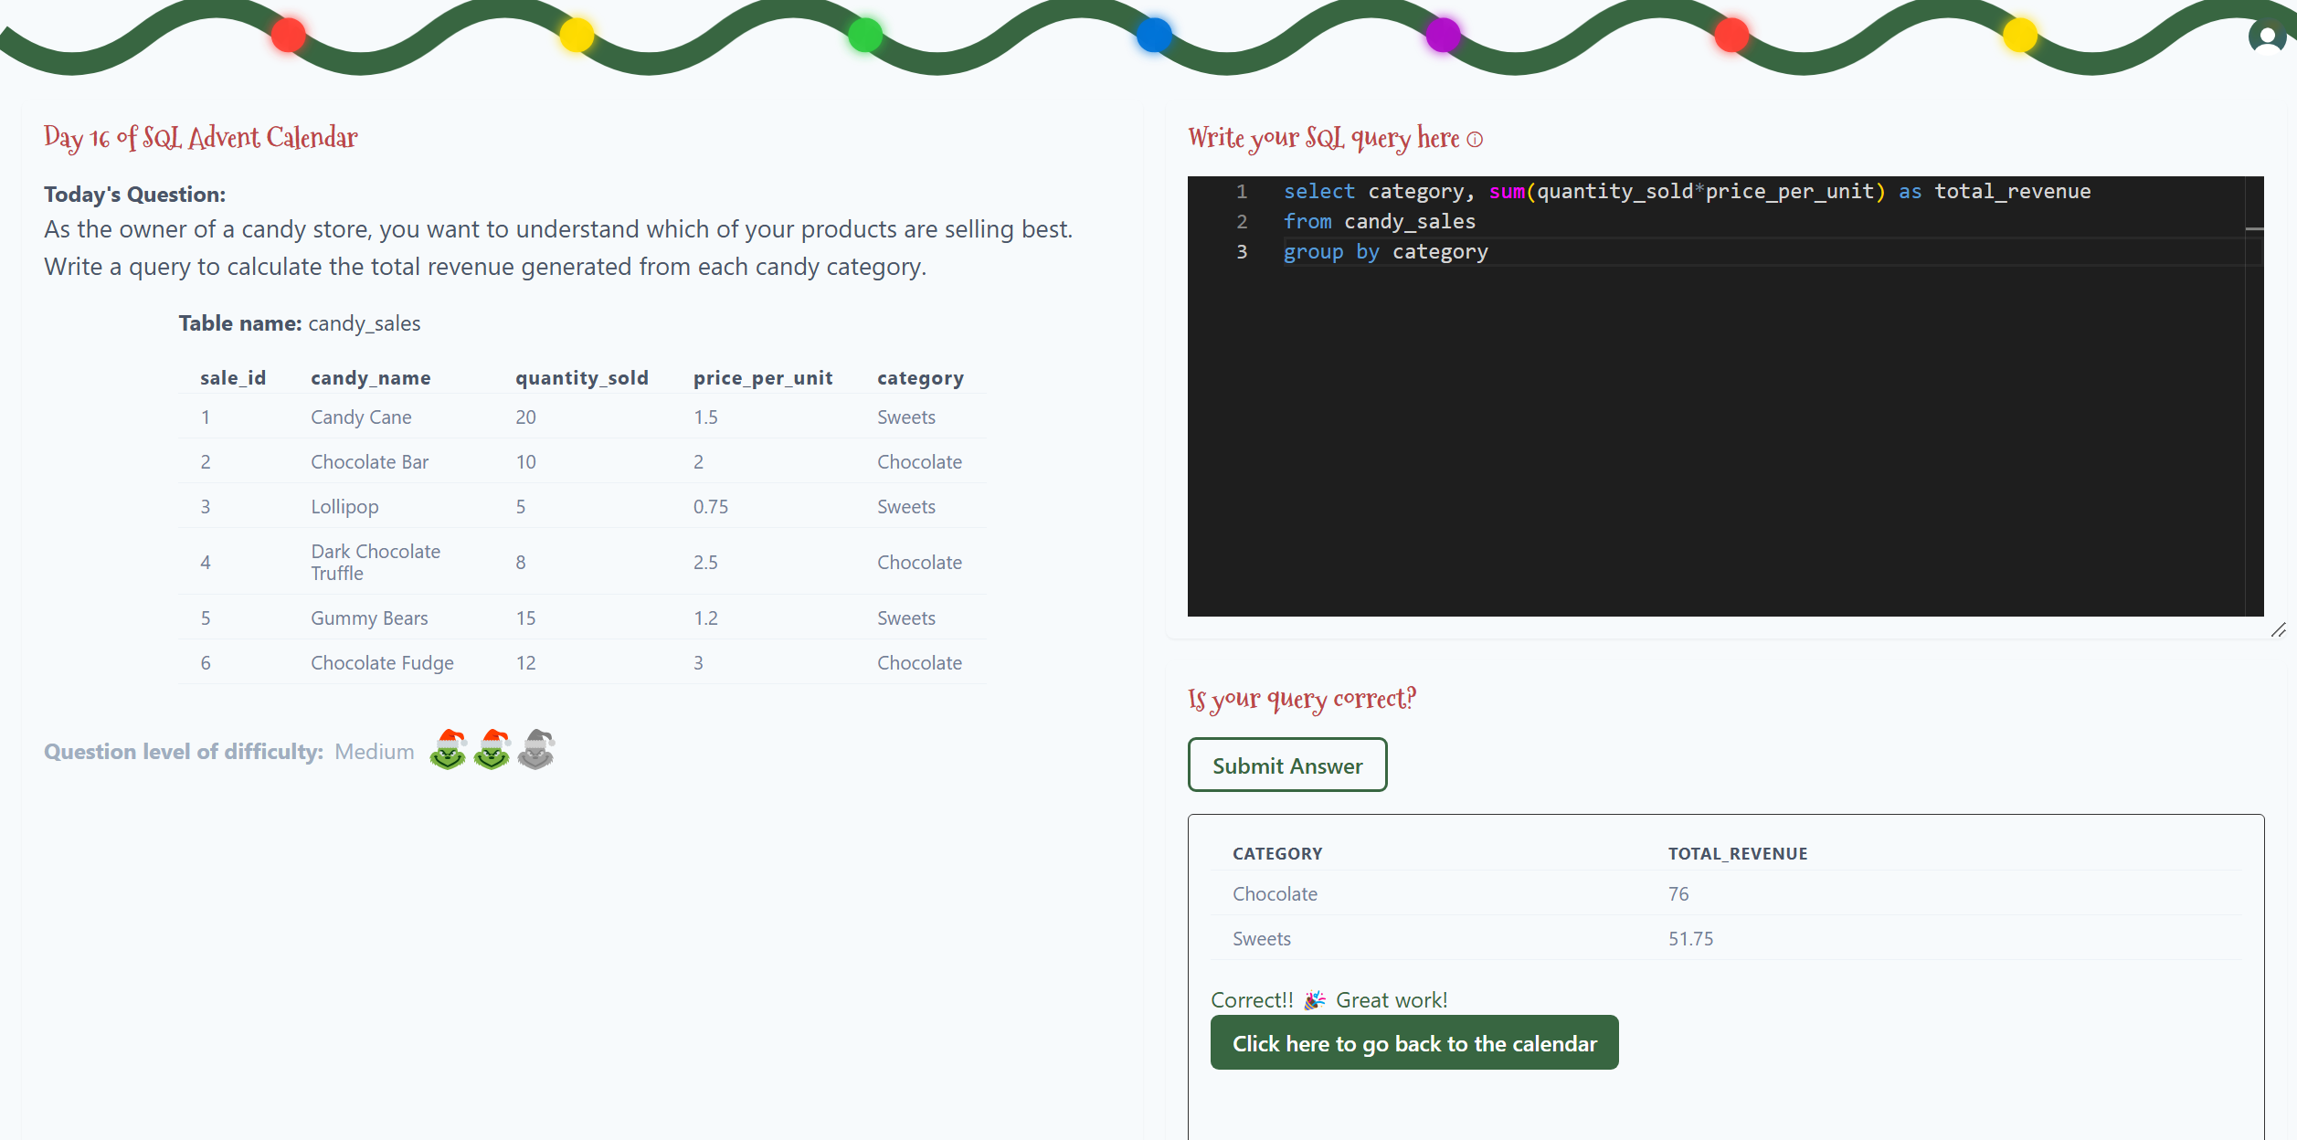
Day 16

Slide 18
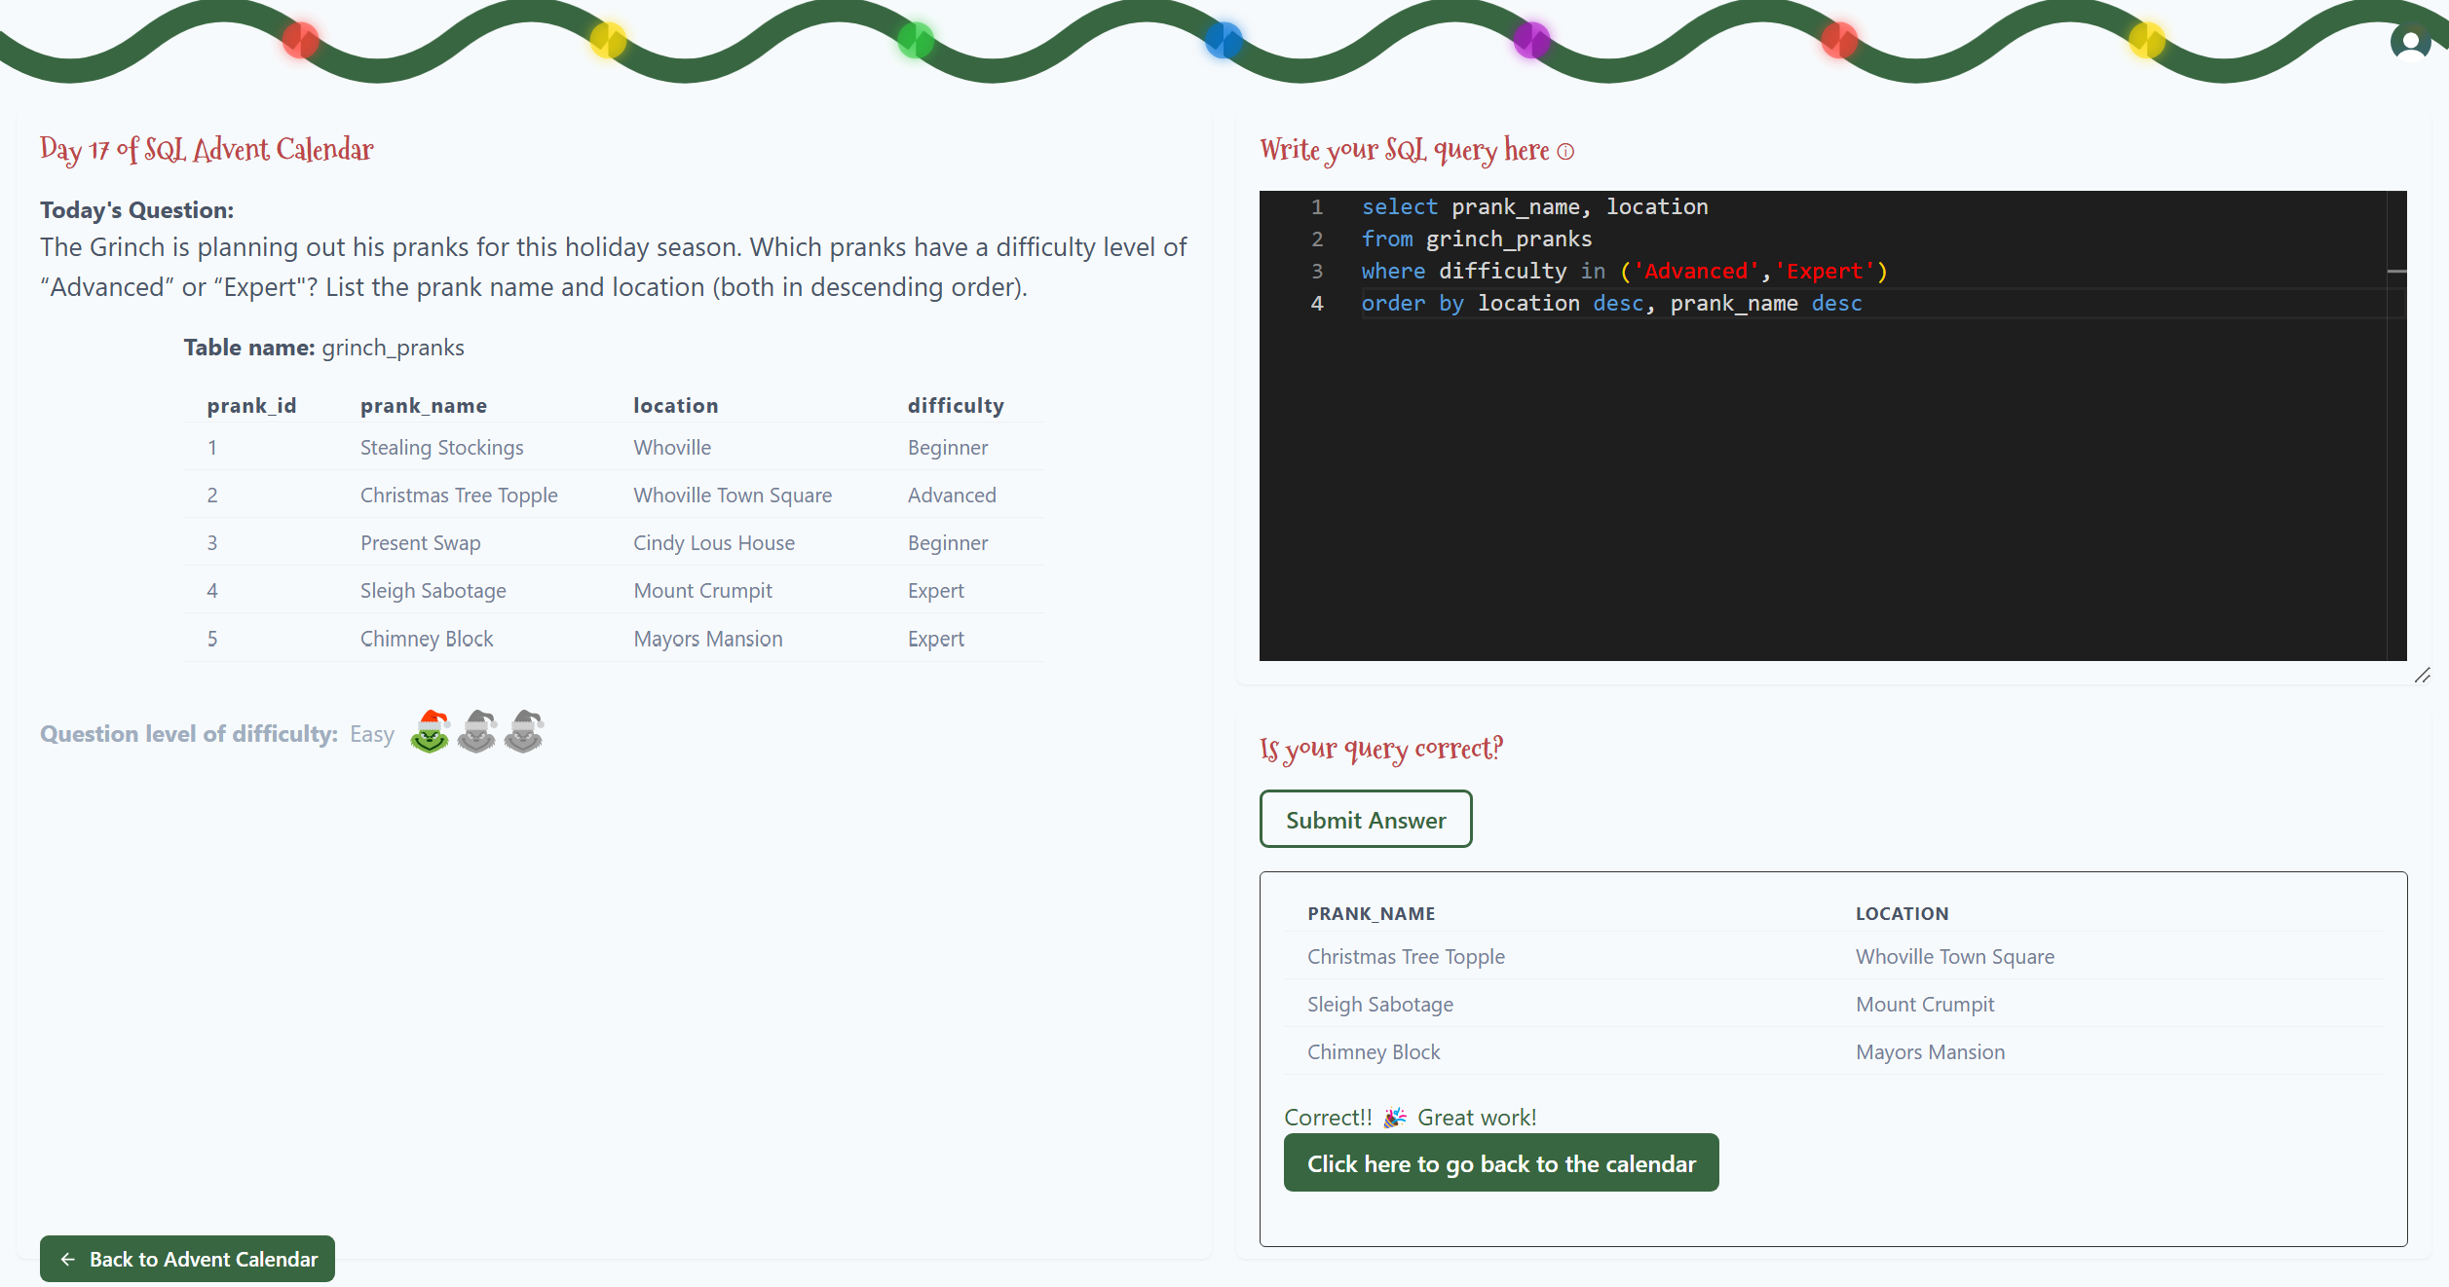
Day 17

Slide 19
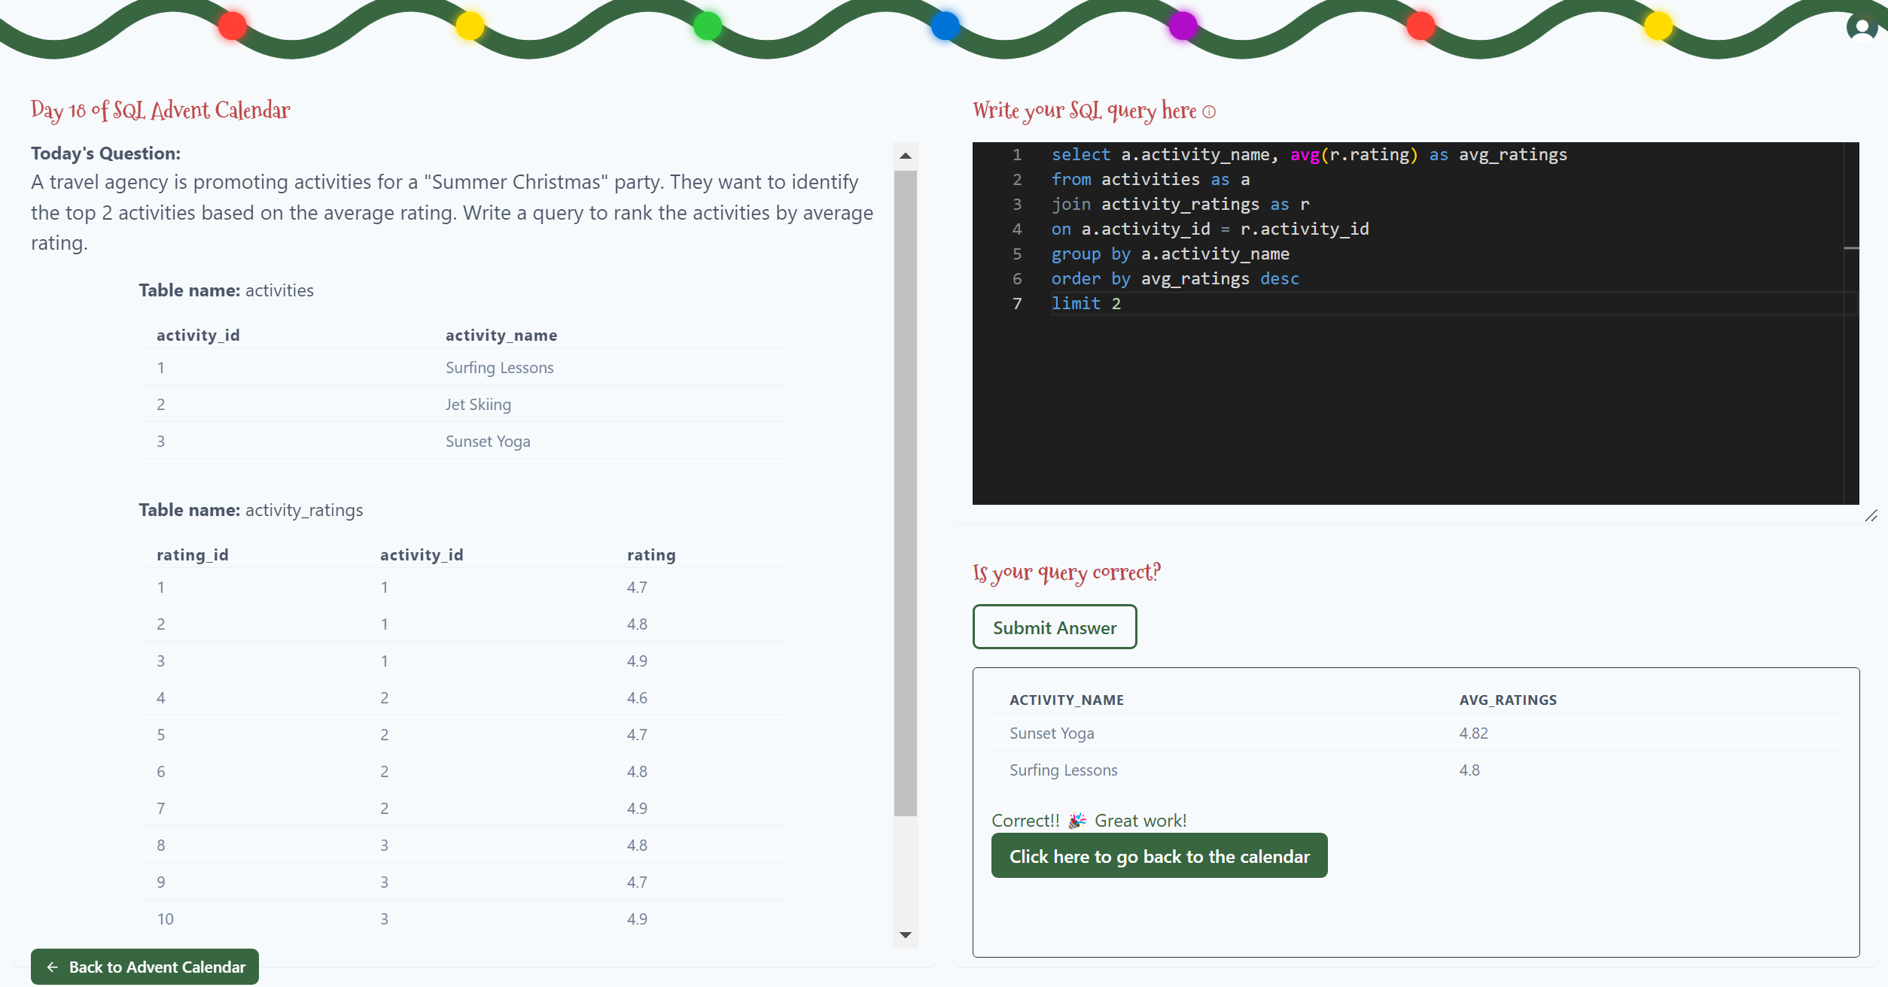
Day 18

Slide 20
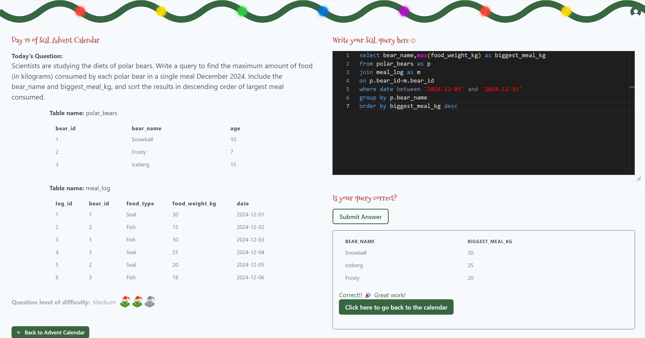
Day 19

Slide 21
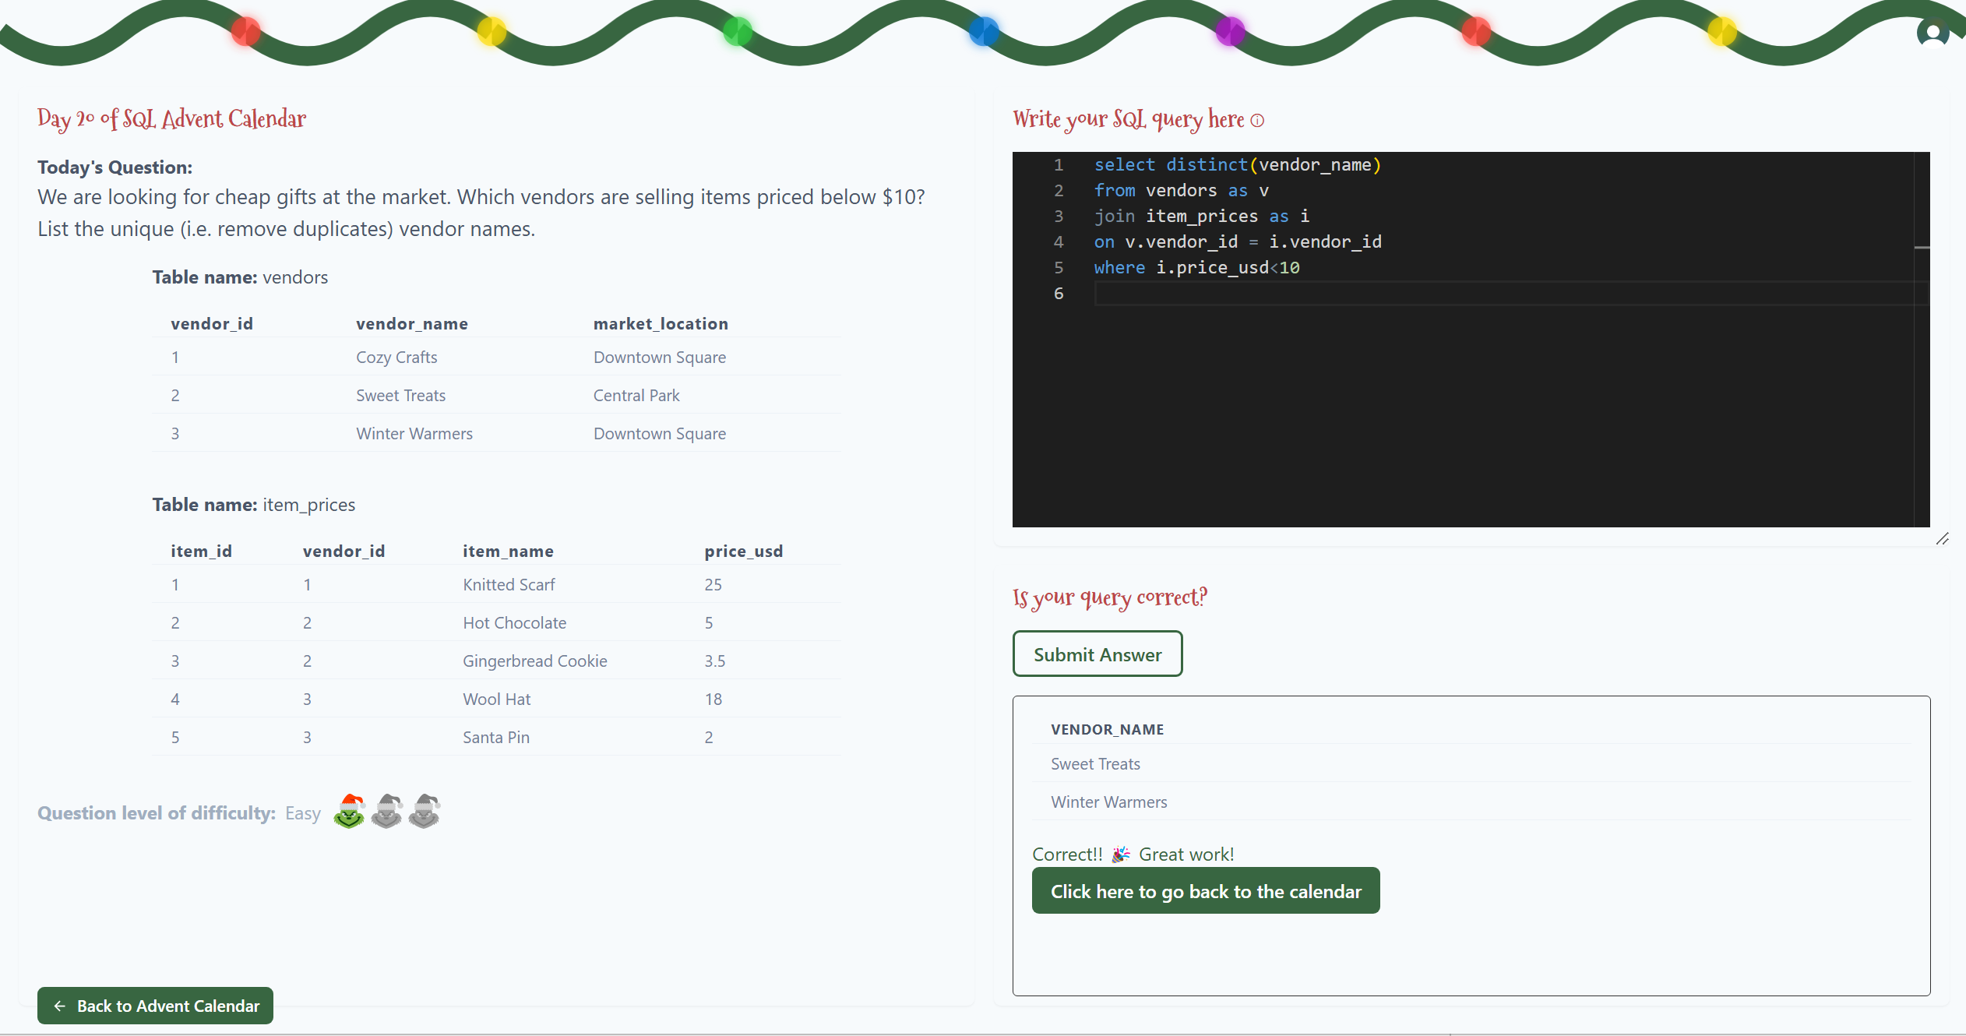
Day 20

Slide 22
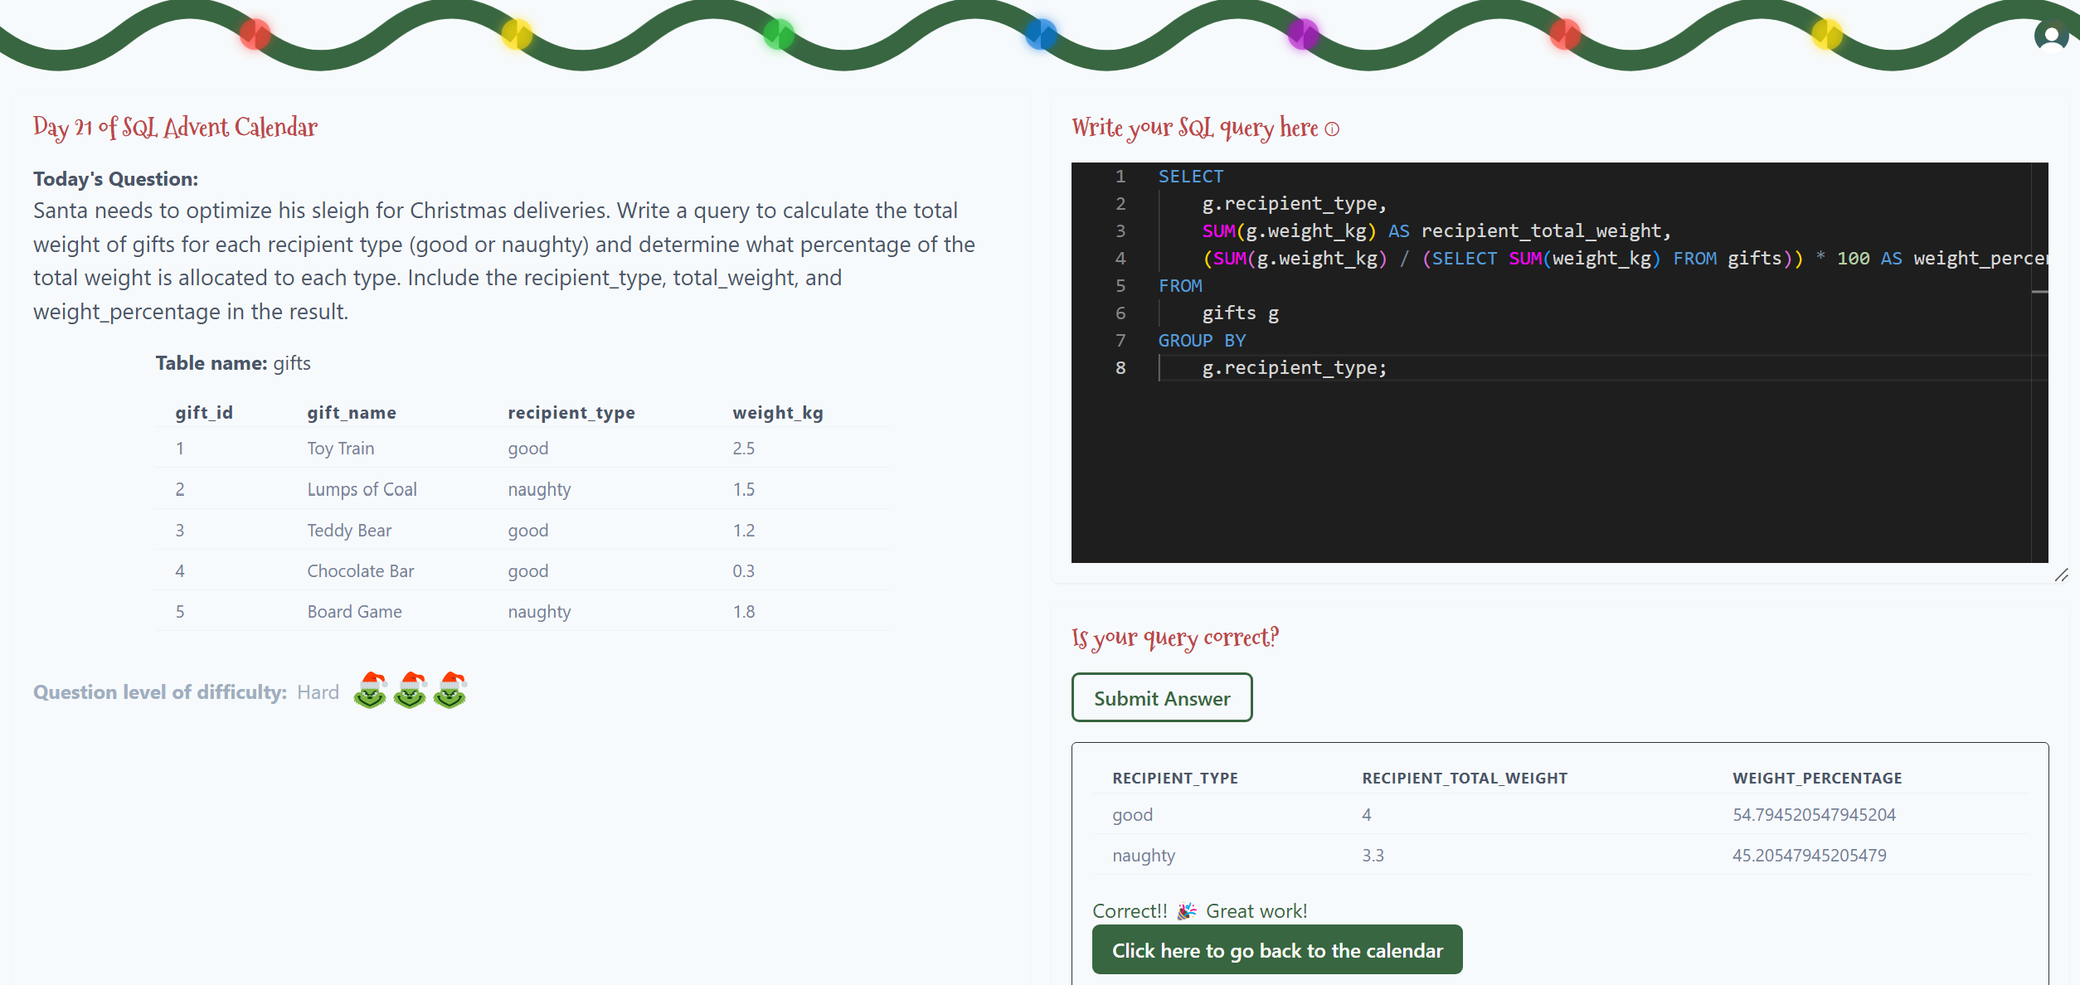
Day 21

Slide 23
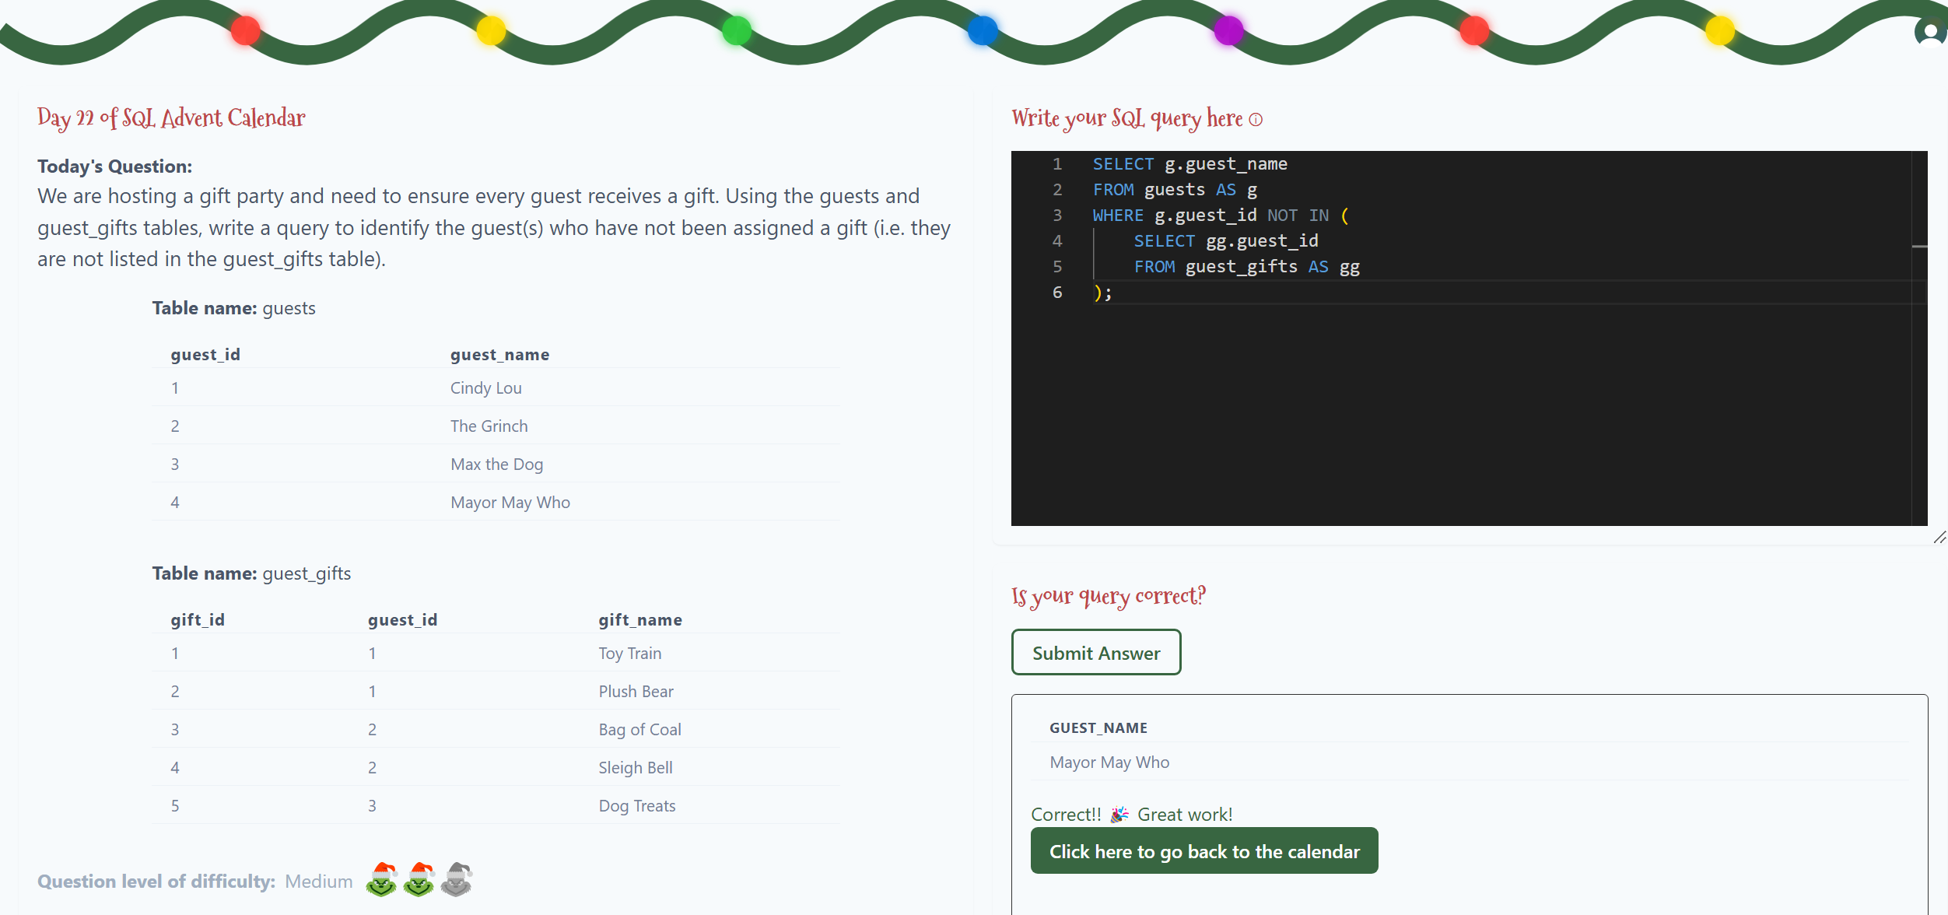
Day 22

Slide 24
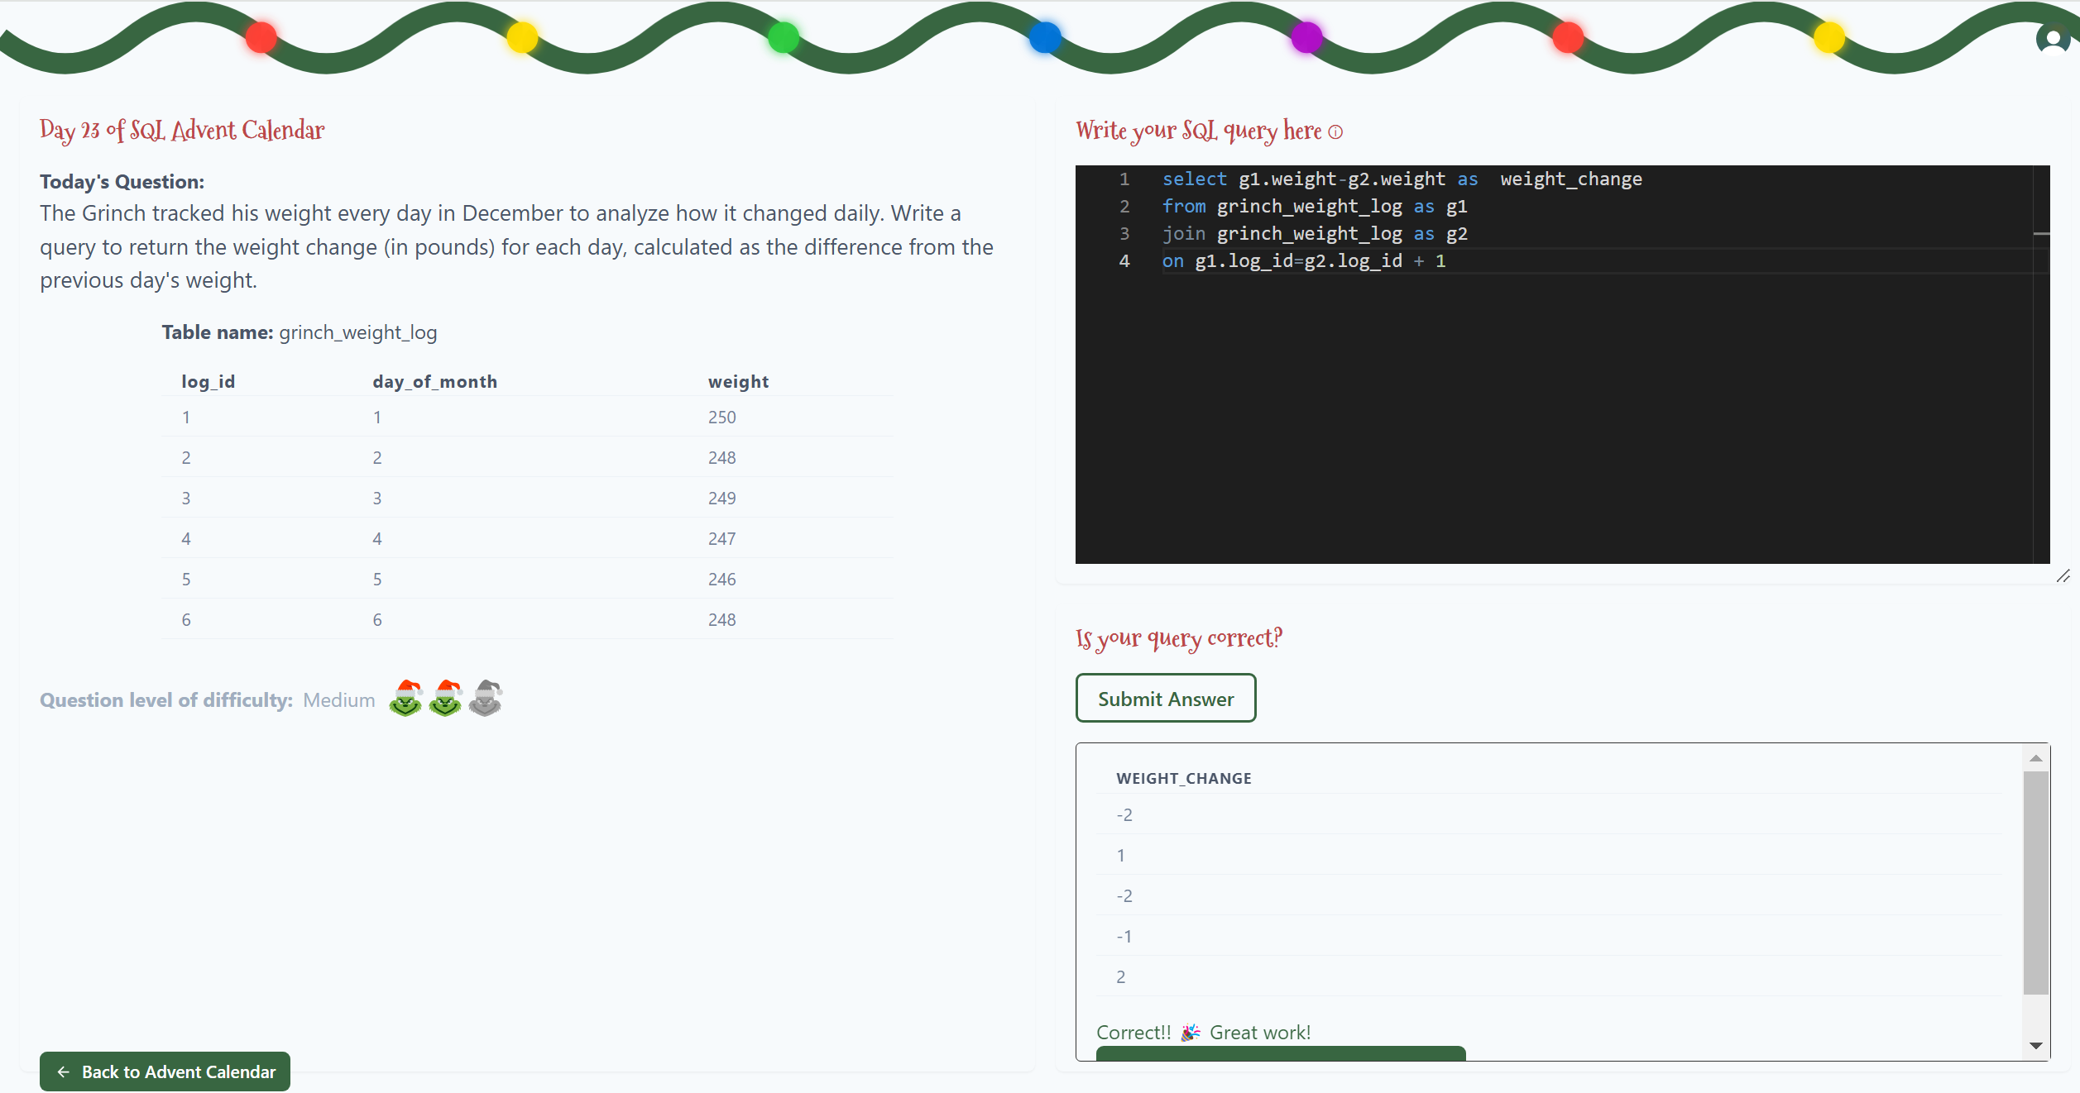
Day 23

Slide 25
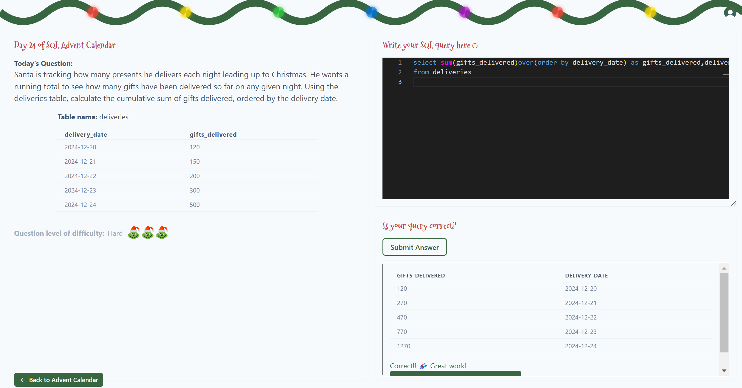
Day 24

